Slide 1
CI /CD
CI/CD is a process of automating code integration, build creation, and testing.

Slide 2
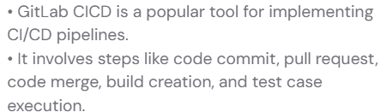

Slide 3
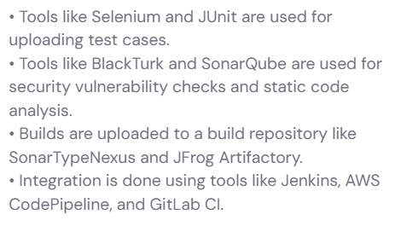

Slide 4
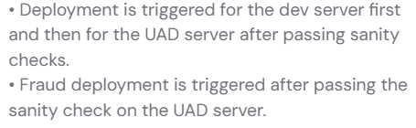

Slide 5
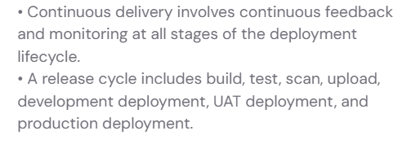

Slide 6
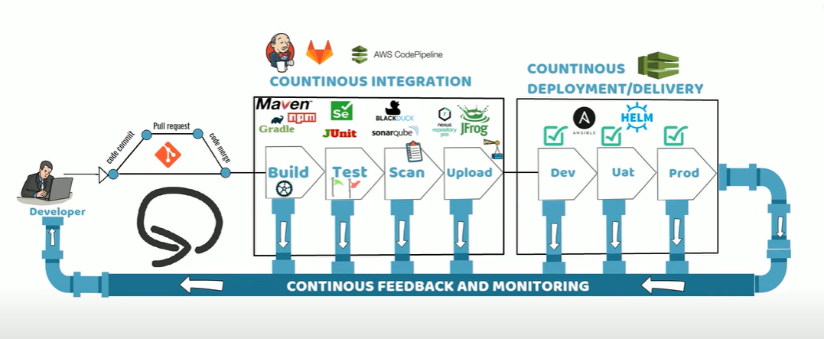

Slide 7
What is Jenkins?
Jenkins is an open-source automation server.
It helps automate the parts of software development related to building, testing, and deploying, facilitating Continuous Integration and Continuous Delivery (CI/CD).

Slide 8
Why Use Jenkins?
Automates code builds and tests
Integrates with Git, Docker, Maven, Kubernetes, etc.
Supports pipelines for end-to-end automation
Has 1800+ plugins for customization
Works across different OS platforms

Slide 9
Term | Description
Job/Project | A task to be executed (e.g., build a project)
Build | A single run of a job
Node | A machine where Jenkins runs jobs (Master or Agent/Slave)
Pipeline | A series of steps (scripted or declarative) to define CI/CD workflow
Plugin | Add-on that gives Jenkins extra functionality (e.g., Git plugin, Docker plugin)

Slide 10
Jenkins Setup Basics
Install Jenkins
Download from jenkins.io
Run with Java (java -jar jenkins.war) or install via Docker
Access Jenkins Dashboard
Go to http://localhost:8080 in your browser
Enter the admin password (found in the Jenkins home folder)

Slide 11
Install Suggested Plugins
During setup, Jenkins will recommend a few plugins—install them.
Create First Admin User
Set up username, password, and email.

Slide 12
Creating Your First Job
Click “New Item”
Enter a name
Choose “Freestyle project”
Configure:
Source Code Management (Git)
Build Trigger (e.g., Poll SCM or on Push)
Build (e.g., Execute Shell or Invoke Maven)
Click “Save” and then “Build Now”

Slide 13
Think of a Job as:
"Tell Jenkins what to do and when to do it."
Jobs are the core unit of automation in Jenkins.
Automating Repetitive Work
Enabling Continuous Integration (CI)
Setting Up Continuous Delivery (CD)
Custom Workflows and Pipelines
Integrations

Slide 14
End-to-End CI/CD Pipeline Implementation using Jenkins, GitHub, Maven, and Docker
Add Required Plugins

Slide 15
Pipeline Graph Analysis | Success
Pipeline: REST API | Success
Pipeline: Stage View | Success
Dev Tools Symbols API | Success
Javadoc | Success
JSch dependency | Installing
Maven Integration | Pending
Authentication Tokens API | Pending
Docker Commons | Pending
SSH server | Pending
Git server | Pending
Docker Pipeline | Pending
HTML Publisher | Pending
Role-based Authorization Strategy | Pending
SSH Agent | Pending
Commons Compress API | Pending
Pipeline Utility Steps | Pending
Loading plugin extensions | Pending

Slide 16
mkdir neww
cd new
mkdir -p src/main/java/com/example
notepad src/main/java/com/example/Application.java
package com.example;
import org.springframework.boot.*;
import org.springframework.boot.autoconfigure.*;
import org.springframework.web.bind.annotation.*;
@SpringBootApplication
@RestController
public class Application {
public static void main(String[] args) {
SpringApplication.run(Application.class, args);
}
@GetMapping("/")
public String home() {
return "CI/CD Working!";
}
}

Slide 17
notepad Dockerfile
FROM openjdk:17
COPY target/*.jar app.jar
ENTRYPOINT ["java","-jar","/app.jar"]
notepad Jenkinsfile
pipeline {
agent any
tools {
maven 'Maven'
}
stages {
stage('Build') {
steps {
bat 'mvn clean package'
}
}
}
}

Slide 18
Create pom.xml
<project xmlns="http://maven.apache.org/POM/4.0.0">
<modelVersion>4.0.0</modelVersion>
<groupId>com.example</groupId>
<artifactId>app</artifactId>
<version>1.0</version>
<parent>
<groupId>org.springframework.boot</groupId>
<artifactId>spring-boot-starter-parent</artifactId>
<version>3.2.0</version>
</parent>
<dependencies>
<dependency>
<groupId>org.springframework.boot</groupId>
<artifactId>spring-boot-starter-web</artifactId>
</dependency>
</dependencies>
<build>
<plugins>
<plugin>
<groupId>org.springframework.boot</groupId>
<artifactId>spring-boot-maven-plugin</artifactId>
</plugin>
</plugins>
</build>
</project>

Slide 19
git init git add . git commit -m "added project files" git branch -M main git remote add origin https://github.com/preetkaur18/neww.git git push -u origin main
VERIFY ON GITHUB
Jenkinsfile pom.xml Dockerfile src folder

Slide 20
Apply restart with Jenkins
Go to Jenkins Dashboard
ci-cd-project
Click on Configure
Scroll down in configuration page
Find the Pipeline Section
Set Definition as:
Pipeline script from SCM
Set SCM as:
Git
Enter Repository URL: https://github.com/preetkaur18/neww.git
Enter Branch: */main
Enter Script Path: Jenkinsfile
Click Save
Apply build now

Slide 21
What is a Jenkins Pipeline?
A pipeline is a set of automated steps that Jenkins follows to build, test, and deploy your application.
Think of it as a scripted flowchart for your DevOps process.

Slide 22
Why Use a Pipeline?
Automate the entire CI/CD process
Make builds repeatable and version-controlled
Run complex workflows (parallel stages, conditional logic, etc.)
Use code to define build steps (called "Pipeline as Code")

Slide 23
Two Types of Pipelines
Type | Description
Declarative | Easier to read and write. Structured and recommended for beginners.
Scripted | More flexible but uses Groovy scripting, best for advanced users.

Slide 24
What Are Plugins in Jenkins?
Plugins are add-ons that extend Jenkins' core functionality.
They help Jenkins integrate with tools like:
GitHub, GitLab
Docker
Slack
Maven, Gradle
JIRA
Kubernetes
And much more!
Basically, if Jenkins needs to do anything beyond basic build automation, there's probably a plugin for it.

Slide 25
Why Are Plugins Important?
Without plugins, Jenkins is just a basic automation server. Plugins let you:
Connect to source code repositories (e.g., Git plugin)
Add build tools (e.g., Maven, Gradle plugin)
Send notifications (e.g., Email, Slack)
Use containers (e.g., Docker plugin)
Define complex pipelines (Pipeline plugin

Slide 26
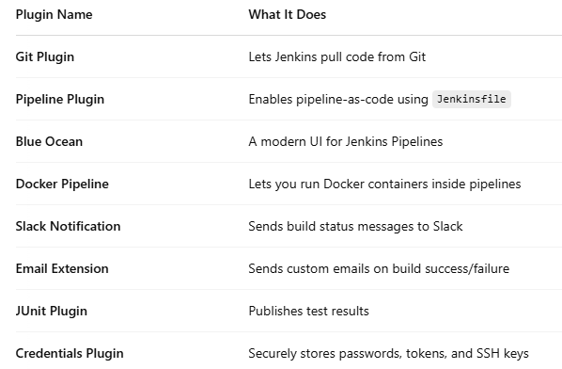

Slide 27
How to Install a Plugin
Go to Jenkins Dashboard
Click on Manage Jenkins
Click on Manage Plugins
Search in the Available tab
Click Install without restart or Download now and install after restart
Too many plugins = performance issues or conflicts. Only install what you need.

Slide 28
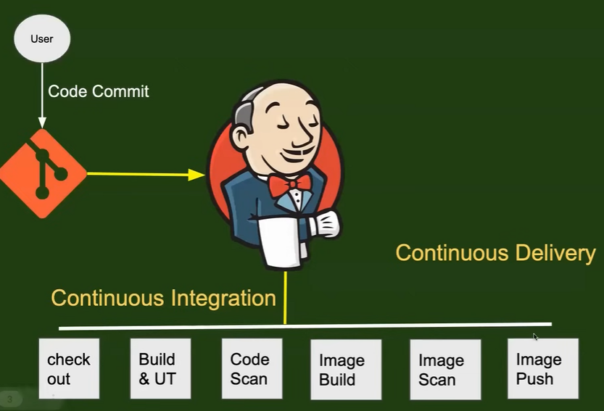

Slide 29
Overview of Jenkins
Jenkins is an open-source automation server designed to assist developers in automating the software development lifecycle.
Initially created for automating the build process for Java, Jenkins now supports a variety of programming languages and technologies.
By automating repetitive tasks—such as building, testing, and deployment—Jenkins allows developers to concentrate on coding.

Slide 30
Key Features of Jenkins
Continuous Integration (CI) and Continuous Delivery (CD) are core features, enabling automatic building, testing, and deployment of code changes.
Jenkins utilizes a rich ecosystem of plugins, which extend its functionality and support automation for diverse tasks in the development workflow.
Jenkins pipelines allow developers to define the entire build, test, and deployment process as code, facilitating version control and collaboration.

Slide 31
How Jenkins Enhances Workflow
By automating routine processes, Jenkins reduces the potential for human error and saves time, streamlining the software development process.
Integrations with other tools in the software development ecosystem make Jenkins adaptable to existing workflows, enhancing productivity.
Developers can write pipeline scripts using Groovy, a domain-specific language, enabling the definition of complex workflows and task automation.

Slide 32
Importance for Developers and DevOps Engineers
Jenkins is considered an essential tool in the software development field, providing significant benefits in CI/CD capabilities.
The automation features of Jenkins enable teams to catch errors and bugs early in the development cycle, improving software quality.
With its robust automation capabilities and wide-ranging integrations, Jenkins empowers developers to focus on creating high-quality code.

Slide 33
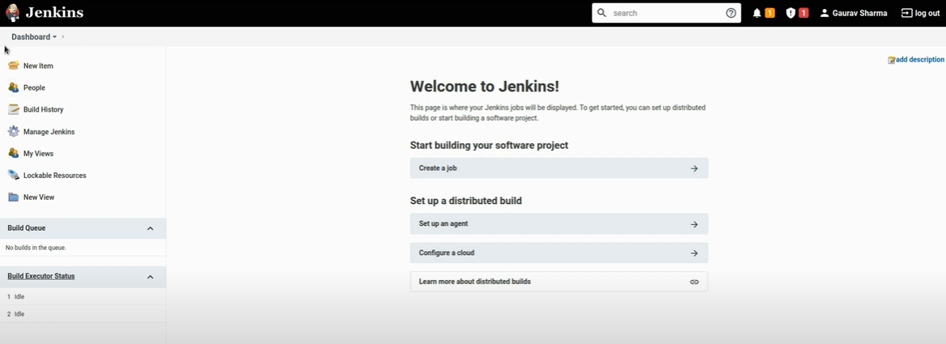

Slide 34
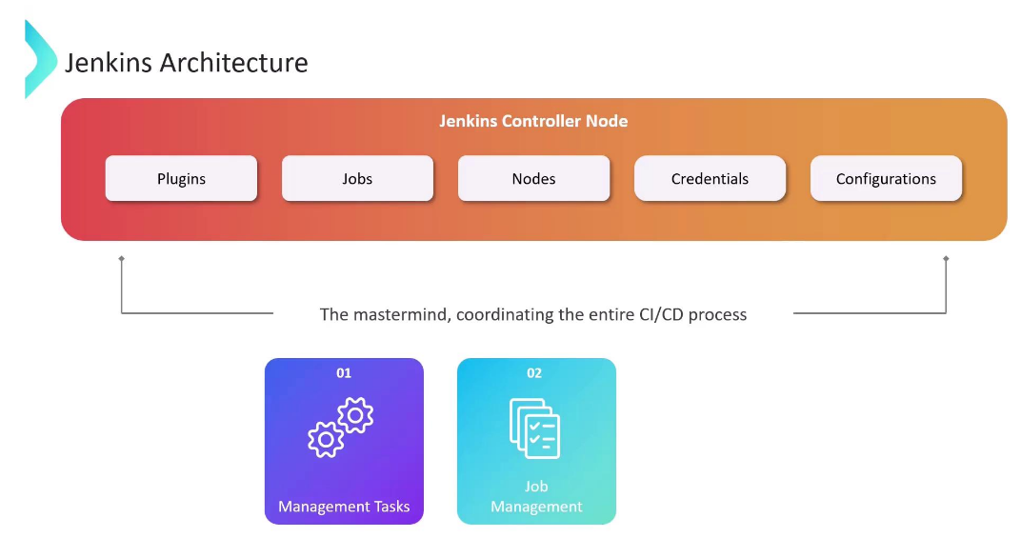

Slide 35
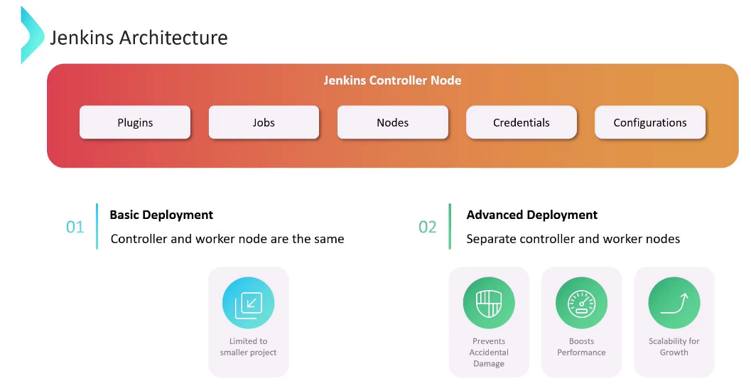

Slide 36
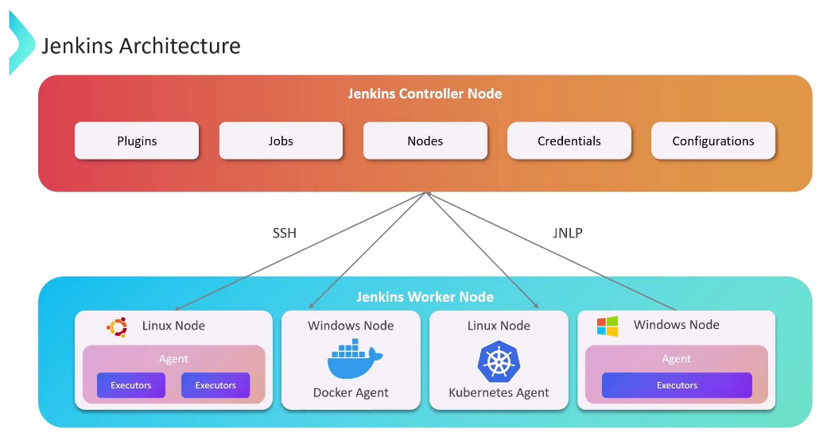

Slide 37
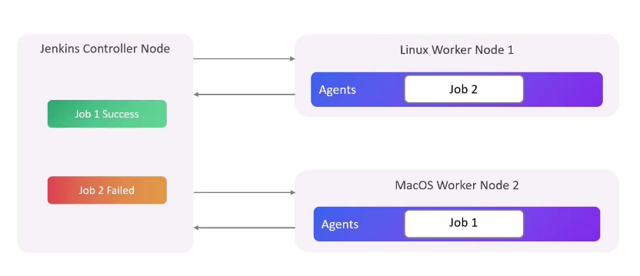

Slide 38
